Slide 1
Patient Appointment Management System - Manish Hundekar
Case study

Slide 2
Contents
Problem Statement
Abstract
Technologies used
Database Schema
API Features
Future Scope

Slide 3
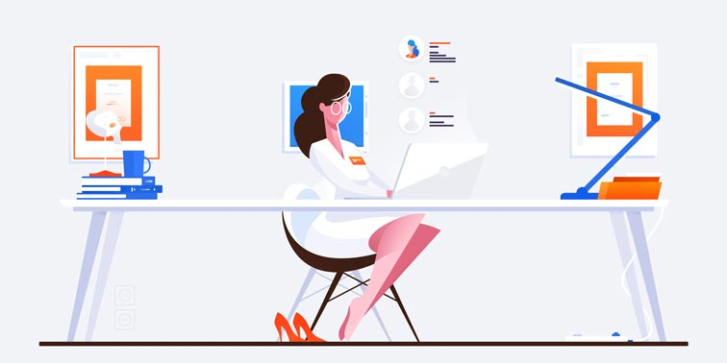
Problem Statement
Doctors are lifesavers and that is why they shouldn’t be too far from those who need healthcare on time. With more and more people having the need to seek medical attention, doctors need to make their services accessible and available to their clients. One way they can do this is offering appointment scheduling for patients in a more centralised manner.

Slide 4

Abstract
Patient Appointment Management Application focuses on maintaining an centralised way of managing appointments which helps the Receptionist in handling many Doctor’s appointment . The application also maintains the patient records , doctor and patient information.

Slide 5



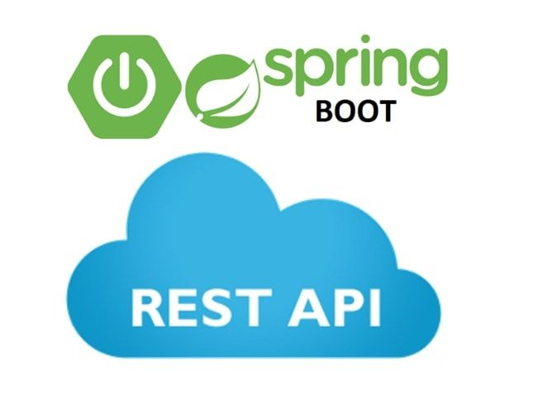

Technologies
Languages used : Java/Kotlin
Build Tool : Maven
Spring Boot
MySQL Server
Mockito
Swagger
UI : HTML/CSS/JS
ReactJS
Bootstrap
Redux
SMS Gateway

Slide 6
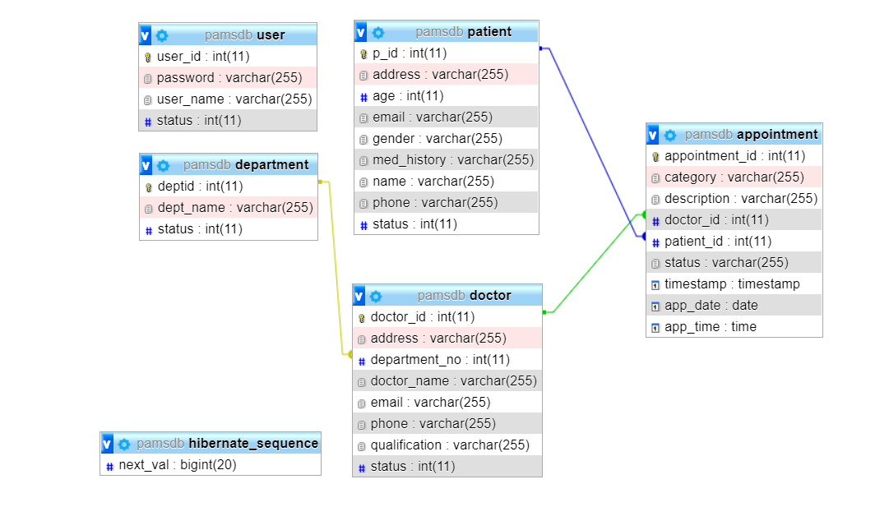
Database Schema

Slide 7
API Functions
Appointment Controller
New Appointment
View all Appointments
View Appointment by Appointment ID
View Appointments by Patient ID
View all Upcoming Appointments
View all Upcoming Appointments by Doctor ID
View all Upcoming Appointments by Doctor Name
Modify Appointment
Cancel Appointment
Confirm Appointment

Slide 8
API Functions
Department Controller
Add Department
View all Departments
View Department by ID
View Department by Name
Modify Department details
Doctor Controller
Add Doctor
View all Doctors
View Doctor by ID
View Doctor by Name
View In-Patient list
Modify Doctor details

Slide 9
API Functions
Patient Controller
Add Patient
View all Patients
View Patient by ID
View In-Patient list
View Out-Patient list
Modify Patient details
Patient Record Controller
View Patient Records by ID

Slide 10
Future Scope
This Application can be integrated with the Hospital Management Application by which the modules can interact mutually for implementing business operations.
This Application can be made online by which the Patients can book or manage booking at their convenience.

Slide 11
Thank You

